Slide 1
Water Meter Protector Set
The project was realized with the support of the Ministry of Foreign Affairs and Trade of Hungary
8th World Water Forum, Brasília
18-23. 03. 2018.
The content of this document does not necessarily represent the official standpoint of the Ministry of Foreign Affairs and Trade of Hungary

Slide 2
The problem
Common experience of public water distribution companies:
The majority of illegal water consumption is attained by damaging or manipulating water meters.
Generally used seals don’t give a sufficient protection from illegal interventions.

Slide 3
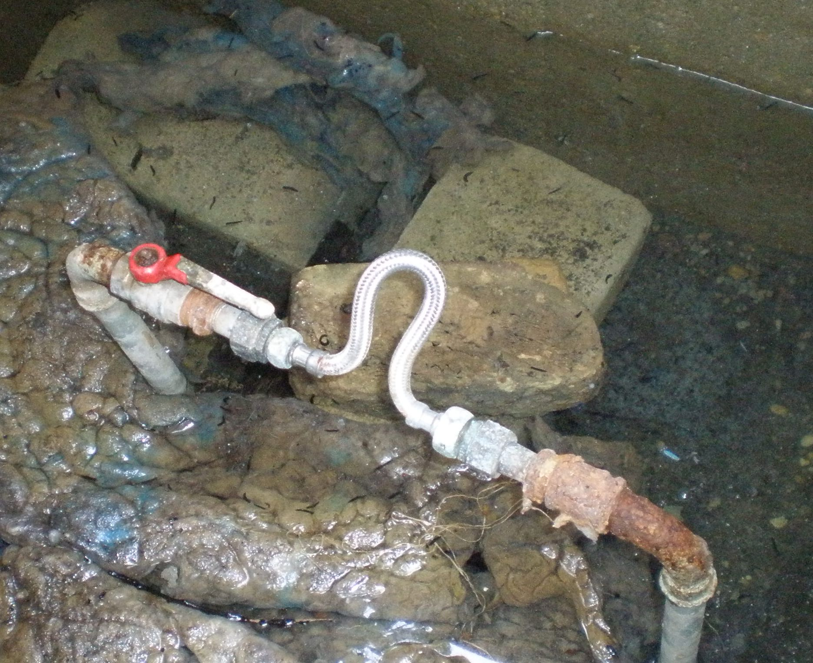
The problem
Average water meter seals can be dismantled easily and many times.
Average water meter seals can be re-mounted in such a way that the manipulation would not be noticeable during meter reading.

Slide 4
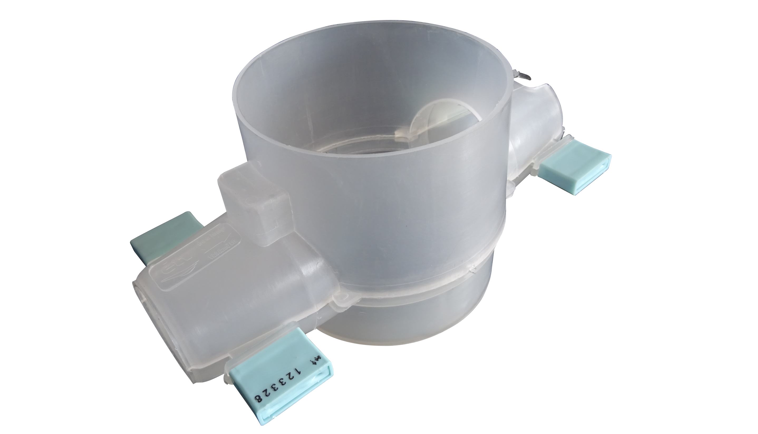
The solution
Water Meter Protector Set – WPS

Slide 5
WPS – Water Meter Protector Set
Unique – Innovative – Safe – Environmentally friendly
Developed by the water supply department of ÉTV Waterworks
Based on the idea of the team’s managing engineer expert
Provides complete protection to water meters
Protects all the critical points:
the joints and the cover structure of the meter

Slide 6
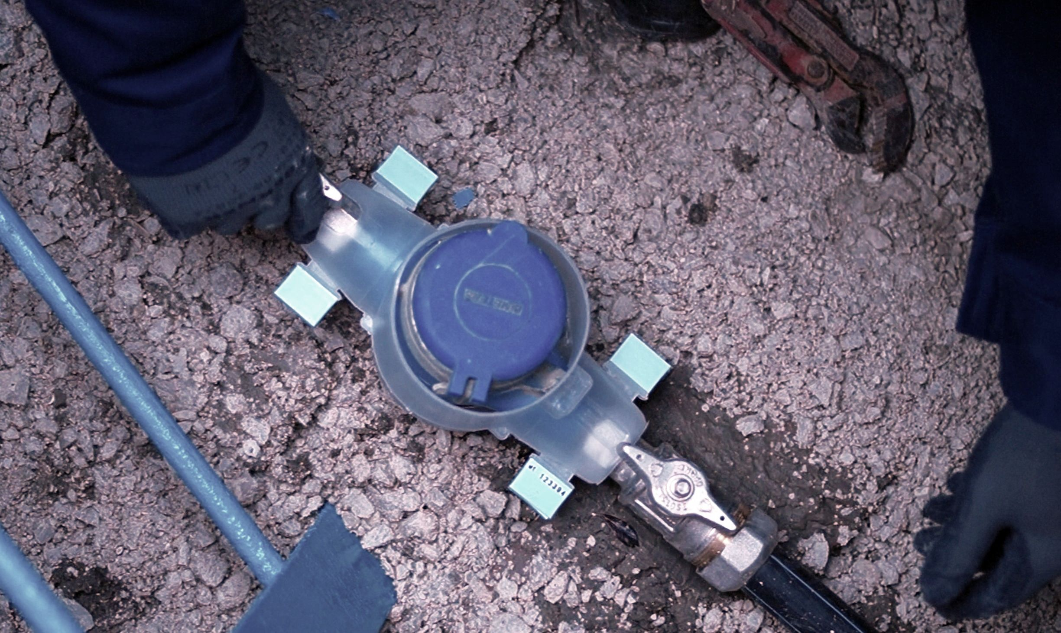
WPS – No more steals with these seals!

Slide 7
WPS - Advantages
Obvious | Any kind of attempt to remove or manipulate the meter shall be instantly visible and provable.
Monitorable | Usage of the WPS significantly reduces water losses caused by illegal drainage based on the manipulation of water meters.
Economical | ÉTV Waterworks registered a 20,1 % reduce in water loss during the first 5-year usage of the WPS system.
Environmentally friendly | The quantity of saved water equals the annual consumption of 20 thousand families
Regulating | Since the introduction of the WPS system, attempts to manipulate the water meters have virtually stopped.

Slide 8
Decreasing of water loss amount in 5 years

Slide 9
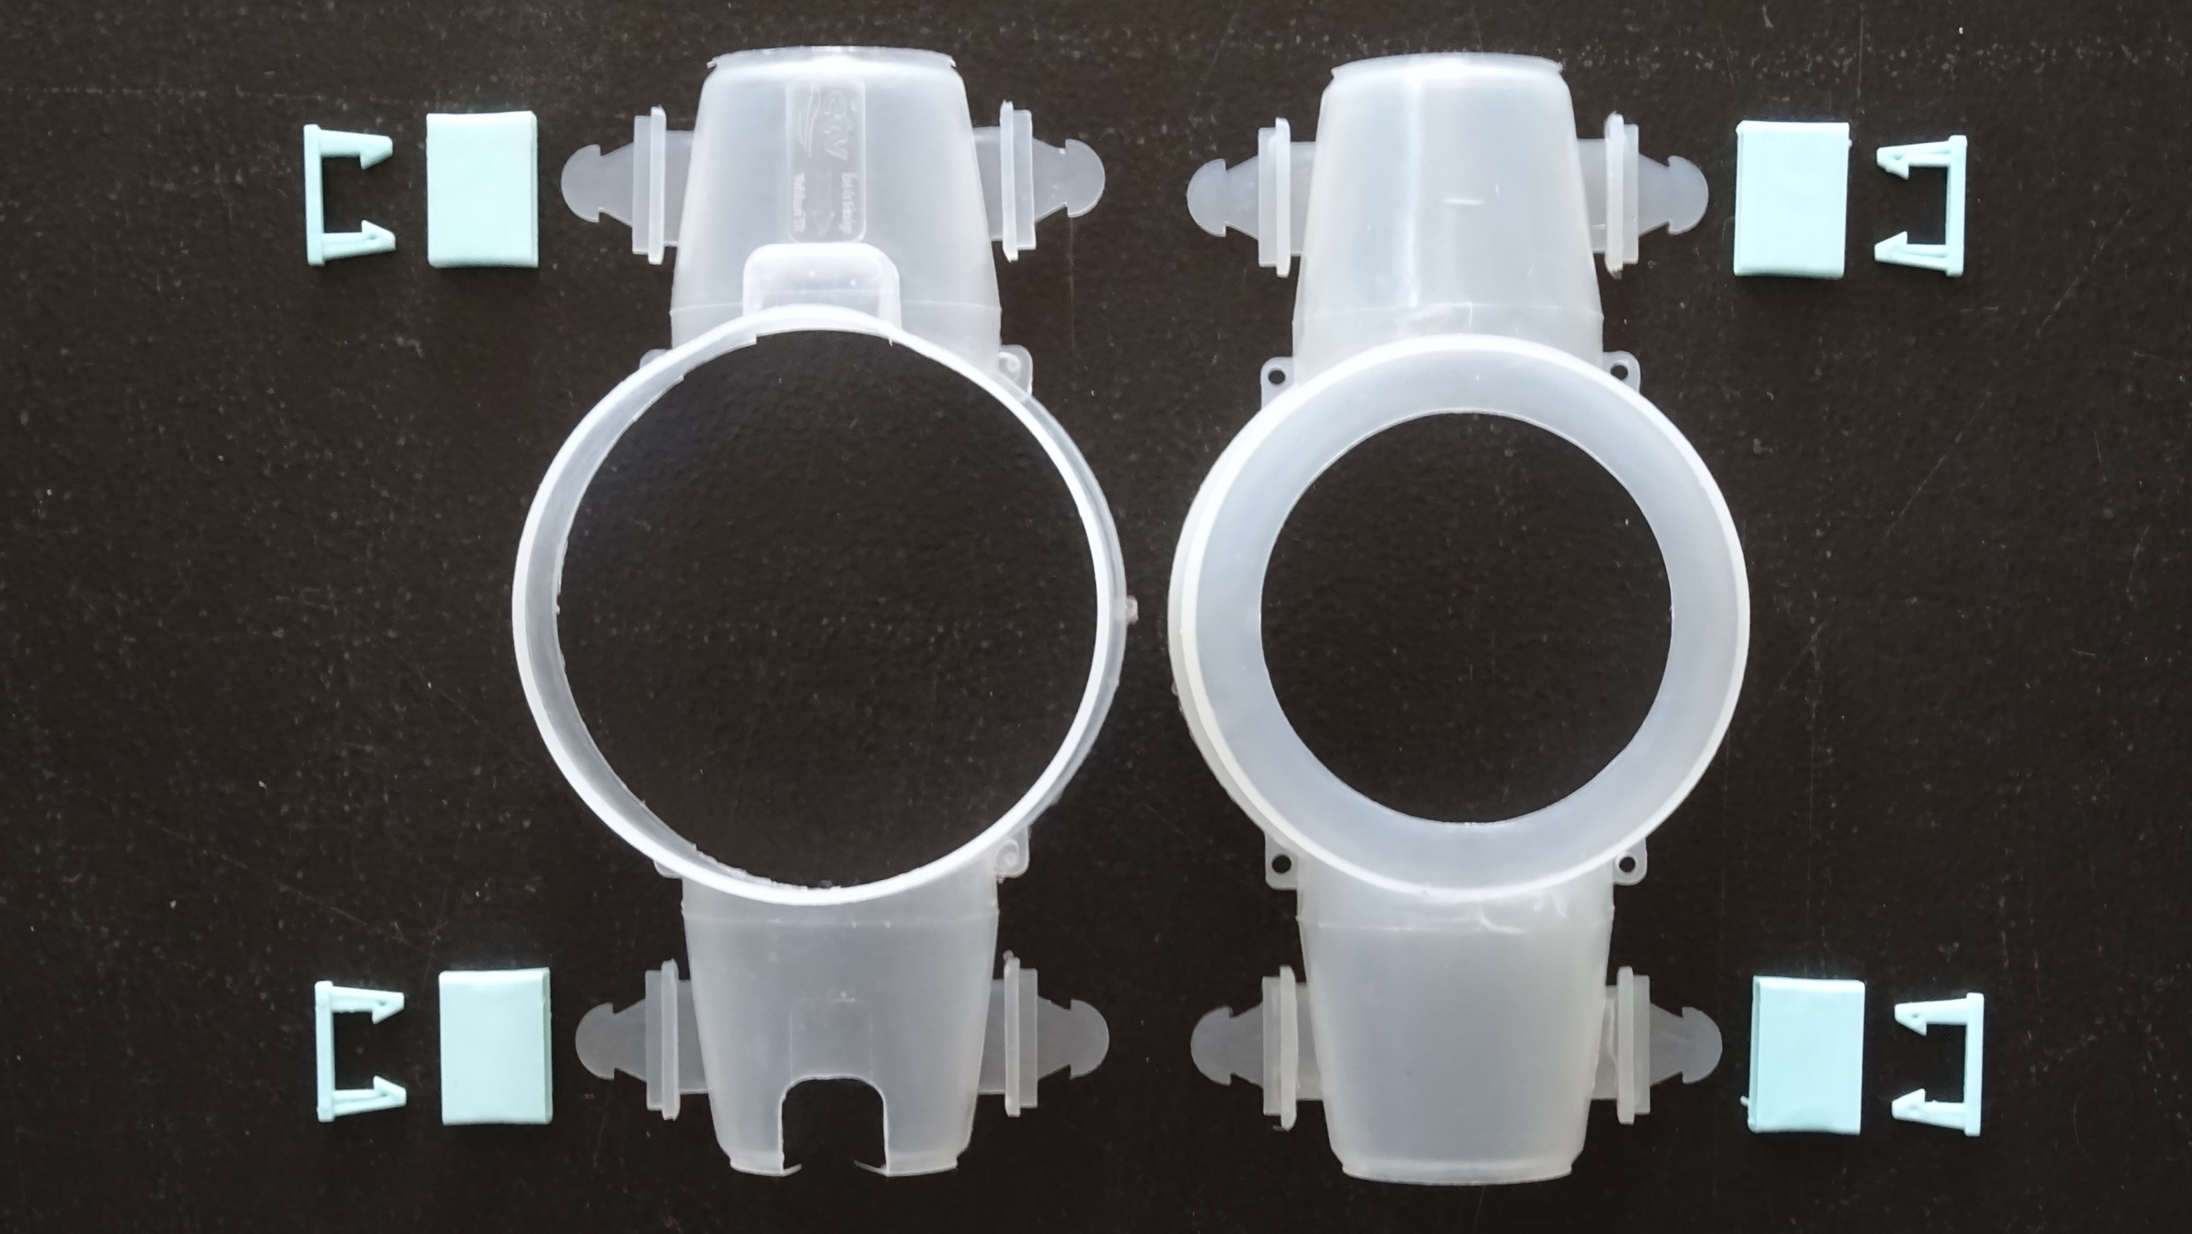
WPS – Mechanical parameters.
WPS box: 2 main units and 4 safety seals
The seals are manufactured in annually changing colours, making the traceability easier

Slide 10
WPS – Recommended to
We recommend the usage of WPS for public water distribution companies, who:
Wish to minimize their losses originating from illegal drainage.
Wish to increase their revenue by increasing the registered water use.
Wish to increase their revenue by increasing their drainage revenue as well.
Wish to filter the unauthorized users and to pay a higher degree of attention for controlling them.
Wish to reduce and control the wastage of drinking water.
Wish to ease their annual financial losses with additional revenue.

Slide 11
Why is WPS better?
WPS | Other products
Inaccessibility to the water meter and the joints as well. | They do not provide inaccessibility to the water meter and the joints as well.
The seal can be dismantled only by damaging it, it does not decompose on heating. | They can be dismantled, they decompose on heating.
Temporary removal is always noticeable. | Temporary removal can be done unnoticeably.
Illegal drainage can be fully recognized. | Illegal drainage cannot be recognized easily, it is not traceable.
Manipulation can be proven, legal proceedings may be initiated. | They do not provide the exclusion of manipulation, losses can not be revealed.
It helps to reduce the excess use of drinking water. | They do not help to reduce the wastage of water.
Its usage demonstrably reduces losses, increases revenue. | Their usage does not realise their economical countervalue and does not provide additional revenue.

Slide 12
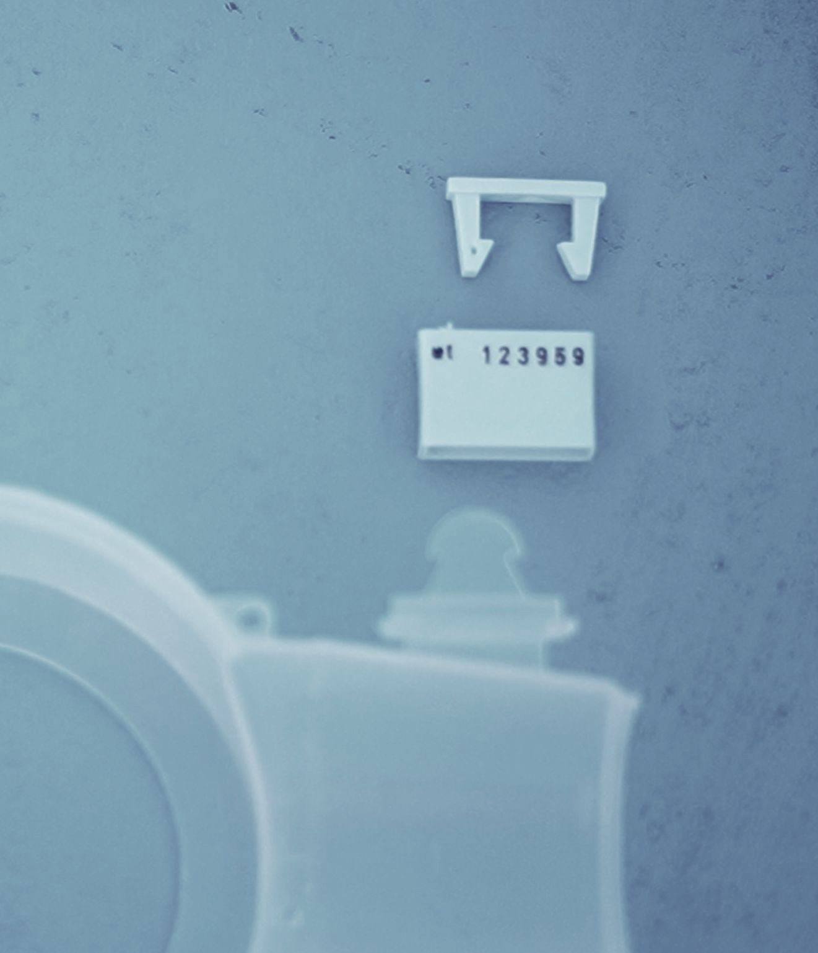
WPS – Mechanical parameters.
One of the seals is equipped with a unique number which cannot be removed. This register number is enhancing the security and the transparency of the system.
The seals can be removed only by damaging them.
It is possible that the company colleague places a red, distinctive and warning seal on the equipment if they detect any signs on the WPS which imply damage, manipulation or other illegal activities.
The system is universal: based on the principle of the WPS, we can prepare the suitable protection for any types of water meters.

Slide 13
WPS - Manufacturing
Manufacturing is performed in Hungary, from Hungarian raw materials. The machinery used for manufacturing is suitable for producing tens of thousands of WPS equipment.
WPS is not commercially available, so its price does not include the price of retail chains.
The unique number is burned into the colourful seals, with professional German technology. Duplication or incomplete number cannot occur, due to the strict protocol. Every sequence starts with a 0, unless the client orders otherwise.
The numbered seals are delivered in a strict sequence and in a practical, easy-to-use container box which is suitable for organization.
Not only the seals but the protecting box can be ordered in different colours (e.g. black) as well.
The WPS can also be ordered with a logo.

Slide 14
Contact Us
wps@erdivizmuvek.hu
Peter Sarosi: +36203374517
http://erdivizmuvek.hu/wps

Slide 15
Thank you for your attention!
The project was realized with the support of the Ministry of Foreign Affairs and Trade of Hungary
The content of this document does not necessarily represent the official standpoint of tha Ministry of Foreign Affairs and Trade of Hungary

